Slide 1
THE sents
Alex Gaskins, Nylayah Jones, Riya Shrestha

Slide 2
Introduction
The SENTS program can be used to track and analyze a person’s mood and energy over time. Users can also enter goals that they desire to achieve. All user inputs are analyzed to provide a relative score and is stored in a personal calendar curated for the user.

Slide 3
Why now?
In a data-driven world, all businesses rely on good customer feedback to improve their product or service. Conducting a sentimental analysis gives businesses the what and why behind the reviews they gather online. It is also beneficial to individuals who are working on improving and maintaining their mental health.

Slide 4
How Does this work?
Computers and humans are not that different, in that we must learn and ingest a bulk of information before we can properly go about tasks on our own. The human brain only knows as much as it has been exposed to. In the case of understanding emotions, a variety of techniques have been tinkered with to allow computers to accurately identify emotions, whether through Natural Language Processing (NLP), or tonal analysis based on vocal input. The common link between any of these methods, is that the computer is first fed template information before it can effectively analyze new inputs.

Slide 5
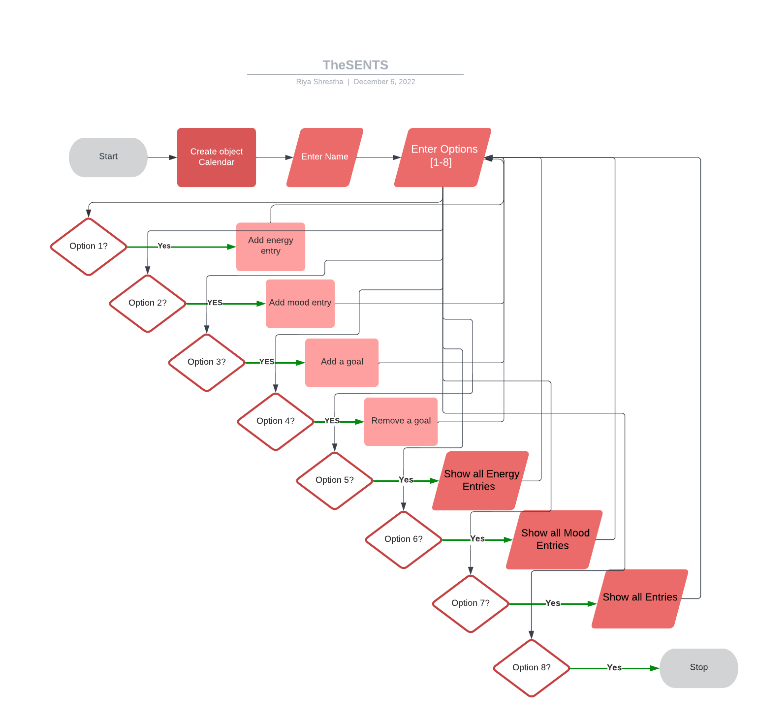
FLOW chart
Calendar
Energy
Mood
Goal
Show entries

Slide 6
Main coding components
Calendar:
Map of energy events
Map of mood events
Displays various events
Word:
Private: String, totalScore
Word Entry
Learning feature
HashTable
User:
Name
Goals - create, delete and store
Energy:
Map of energy events
Displays energy events

Slide 7
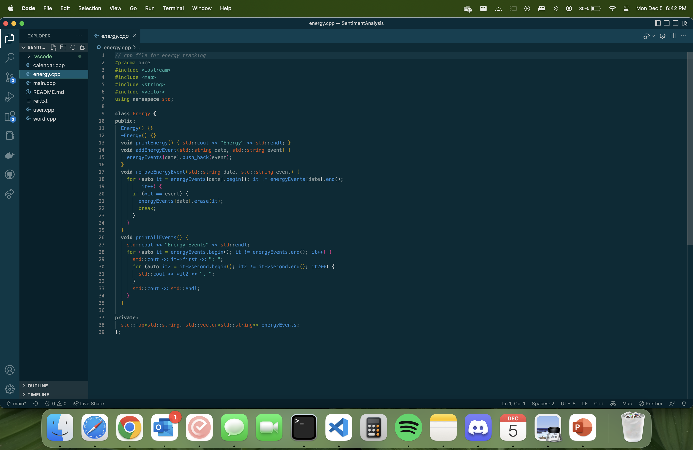
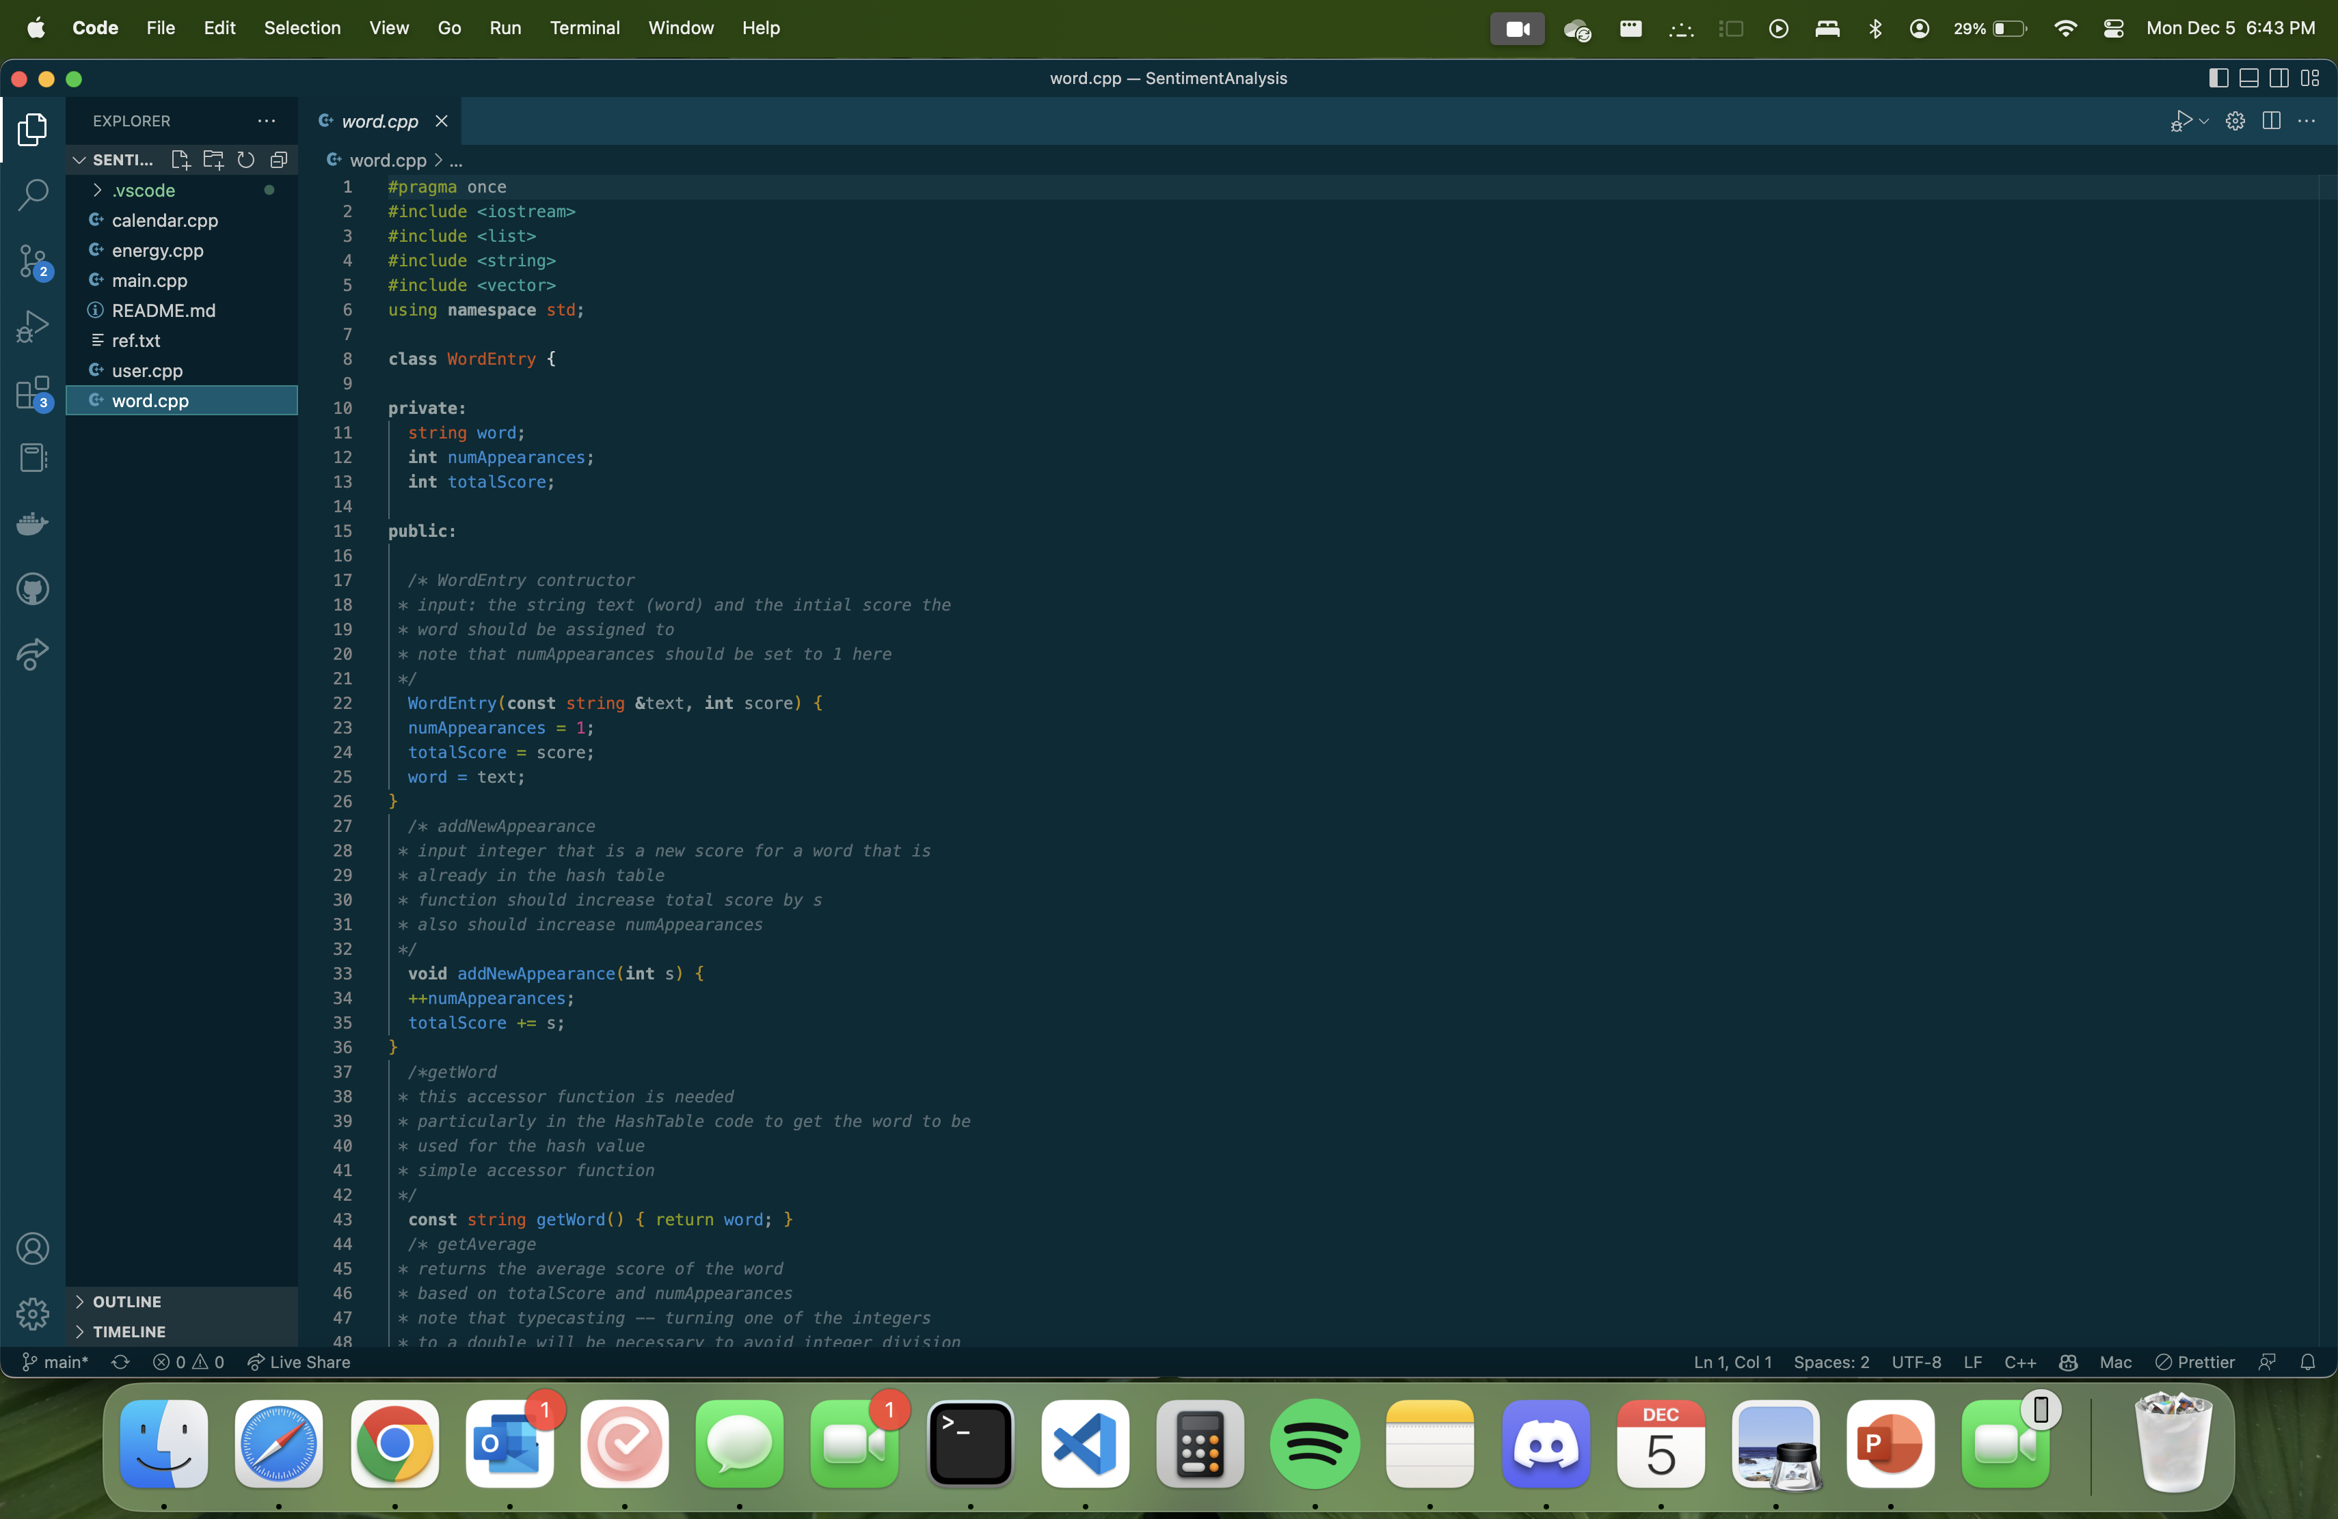
Code screenshots

Slide 8
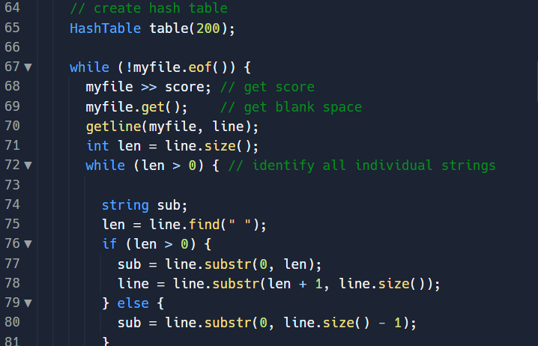
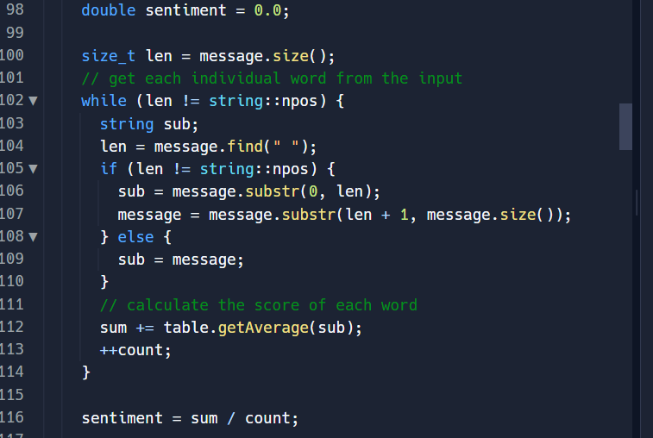
Code screenshots

Slide 9
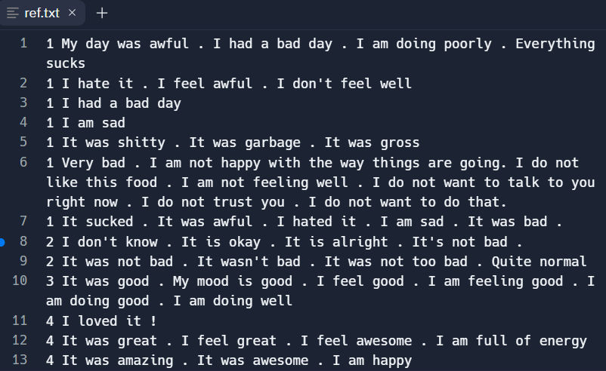
Template Moods

Slide 10
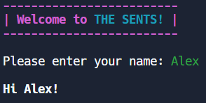
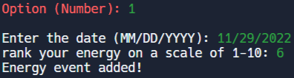
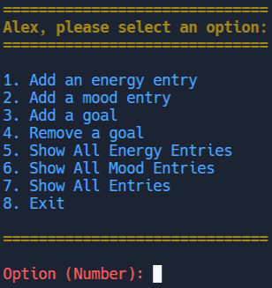
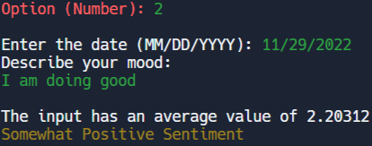
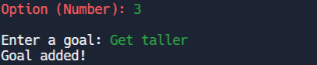
Program Outputs
Launch / Main Menu
Adding Goals and Events

Slide 11
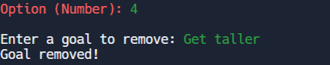
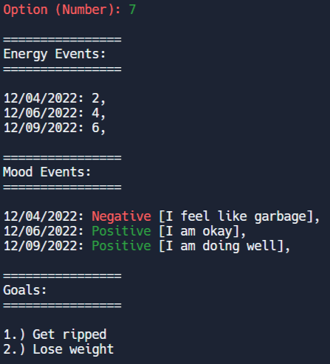
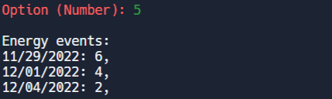
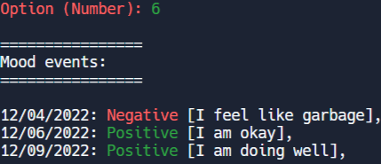
Program Outputs
Goal Completion and Viewing Events

Slide 12
THANK YOU
Questions?

